Slide 1
Republic of Yemen University of Science And Technology Faculty of science and Engineering BioMedical Engineering Department
Presentation of Robotics (4)
Supervised by:
DR. Fadhl M. Alakwaa PhD

Slide 2
CLASSIFICATION OF SENSORS
Notes:
Proprioceptive sensors measure values internal to the system (robot); for example, motor speed, wheel load, robot arm joint angles, and battery voltage
Exteroceptive sensors acquire information from the robot’s environment; for example, distance measurements, light intensity, and sound amplitude. Hence, exteroceptive sensor measurements are interpreted by the robot in order to extract meaningful environmental features.
Passive sensors measure ambient environment energy entering the sensor. Examples of passive sensors include temperature probes, microphones, and CCD or CMOS cameras.
Active sensors emit energy into the environment, and then measure the environmental reaction.

Slide 3
Proprioceptive / Exteroceptive
Passive / Active

Slide 4
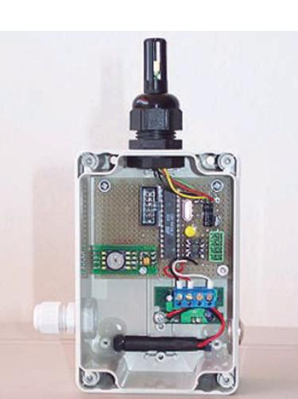
Helpmate from Transition Research Corporation

Slide 5
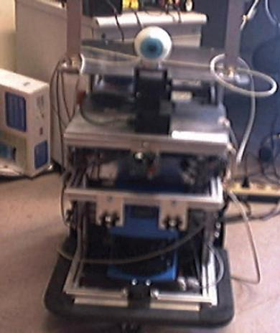
BIBA Robot, BlueBotics SA.

Slide 6
ENCODERS AND DEAD RECKONING

Slide 7
Types Of Rotational Displacement And Velocity Sensors
Brush encoders.
Potentiometers.
Synchros.
Resolvers.
Optical encoders.
Magnetic encoders.
Inductive encoders.
Capacitive encoders.

Slide 8
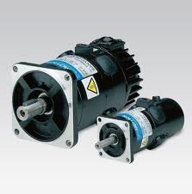
Brush encoders

Slide 9
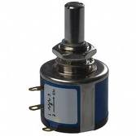
Potentiometers

Slide 10
Synchros

Slide 11
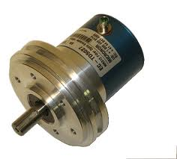
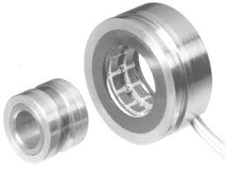
Resolvers

Slide 12
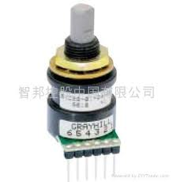
Optical encoders

Slide 13
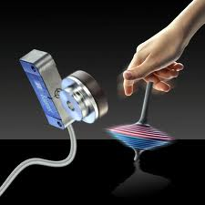
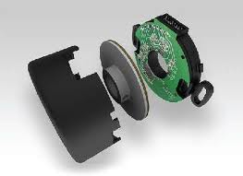
Magnetic encoders

Slide 14
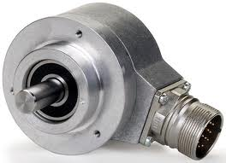
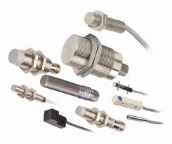
Inductive encoders

Slide 15
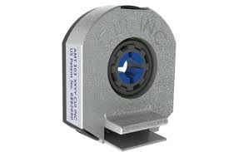
Capacitive encoders

Slide 16
Optical Encoders

Slide 17
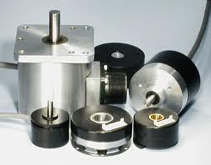
Incremental Optical Encoders

Slide 18
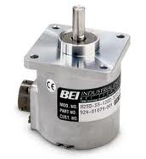
Absolute Optical Encoders

Slide 19
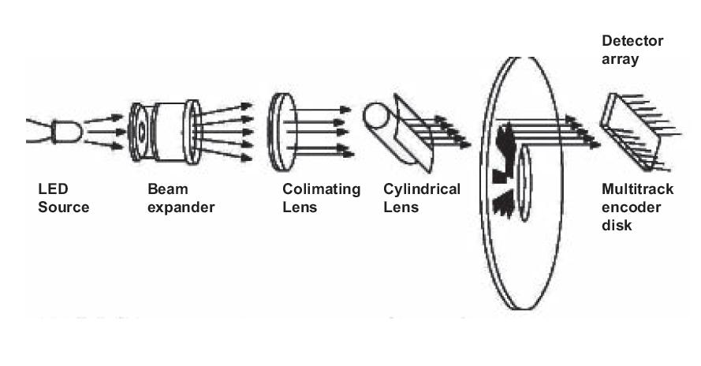

Slide 20
INFRARED SENSORS

Slide 21
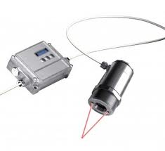
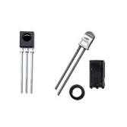

Slide 22
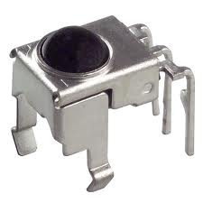

Slide 23
ACCELEROMETERS

Slide 24
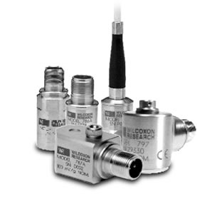

Slide 25
LASER RANGE FINDER

Slide 26
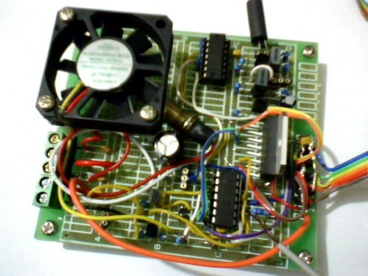
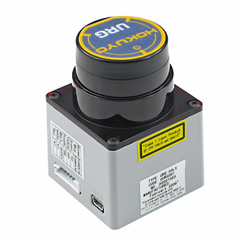

Slide 27
Applications
3D object recognition
3D object modelling
wide variety of computer vision related ﬁelds

Slide 28
VISION-BASED SENSORS

Slide 29
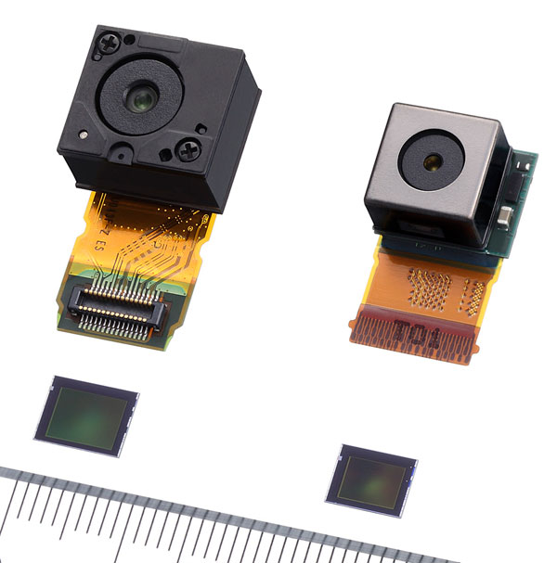
CMOS

Slide 31
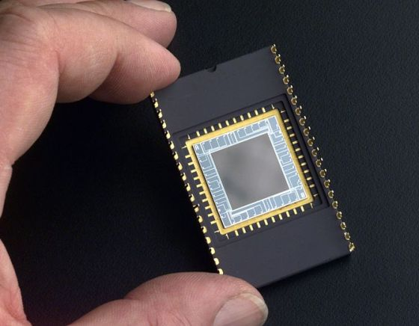
CCD

Slide 32
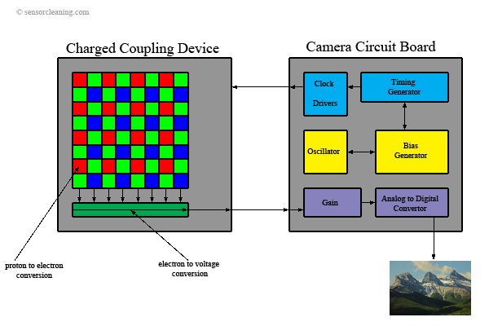

Slide 33
COLOR-TRACKING SENSORS

Slide 34
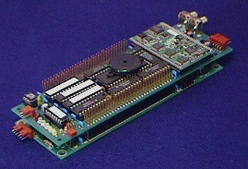
Cognachrome Color-tracking System

Slide 35
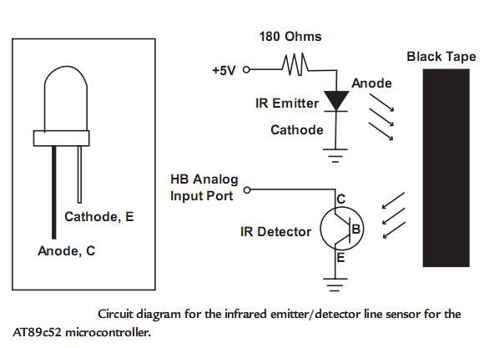

Slide 36
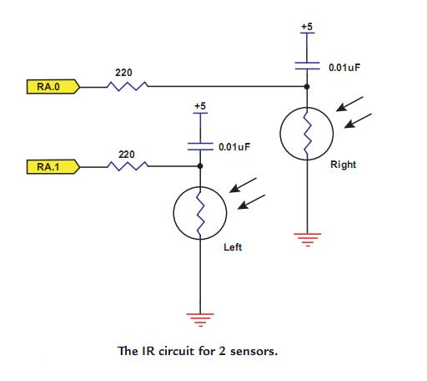

Slide 37
SENSOR MOUNTING ARRANGEMENT

Slide 38
(1) Arrangement 1 – Light beam passing through slots
(2) Arrangement 2 – Light beam is reﬂ ected

Slide 39
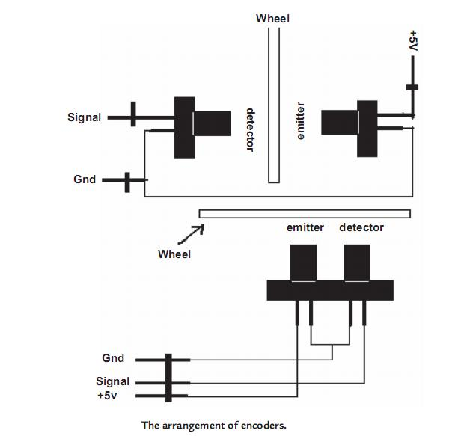

Slide 40
READING THE PULSES IN A COMPUTER

Slide 41
