Slide 1
Republic of Yemen University of Science And Technology Faculty of science and Engineering BioMedical Engineering Department
Presentation of Robotics (3)
Supervised by:
DR. Fadhl M. Alakwaa PhD

Slide 2
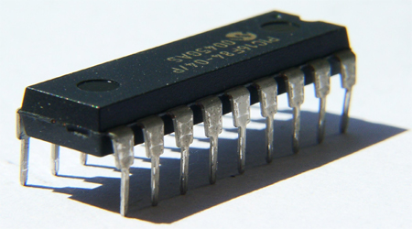
Integrated Circuits

Slide 3
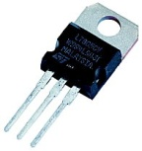
Some Lab Components voltage regulators(+)
IC 7805
IC 7812
IC 7815
IC 7824

Slide 4
Some Lab Components voltage regulators(-)
IC7905
IC7912
IC7915
IC7924

Slide 5
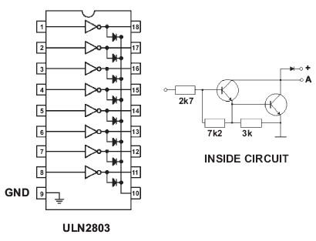
Eight Darlington Arrays

Slide 6
LM 324 IC

Slide 8
USING THE PARALLEL PORT OF THE COMPUTER

Slide 10
LCD

Slide 12
Interfacing the LCD Module to a Parallel Port

Slide 13
SERIAL COMMUNICATION: RS-232

Slide 14
555 Timer

Slide 15
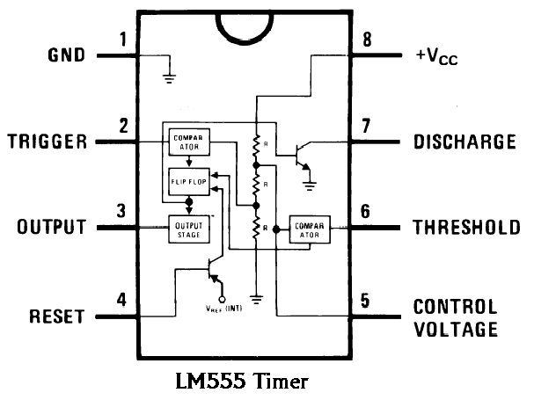

Slide 16
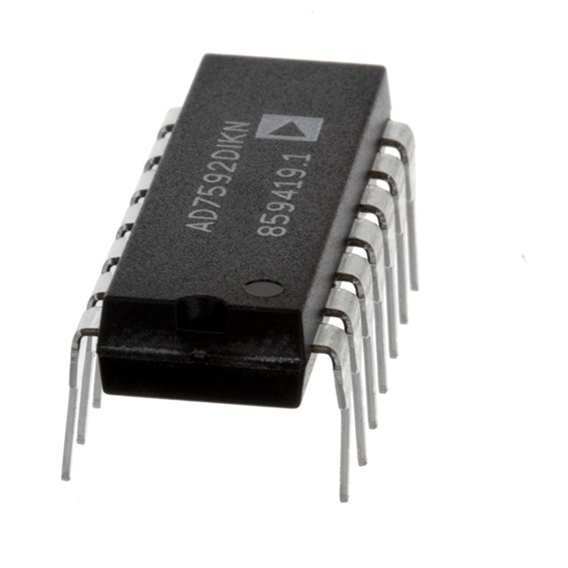
ADC

Slide 18
MICROCONTROLLER

Slide 20
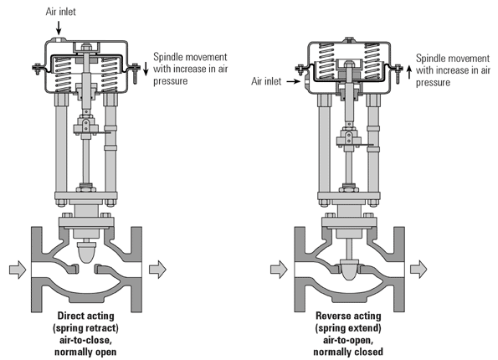
ACTUATORS

Slide 21
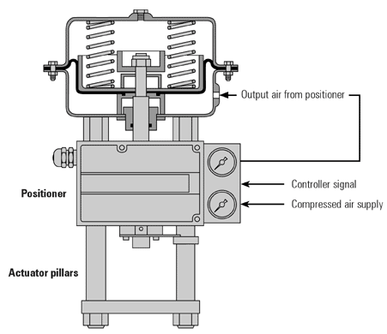
ACTUATORS

Slide 22
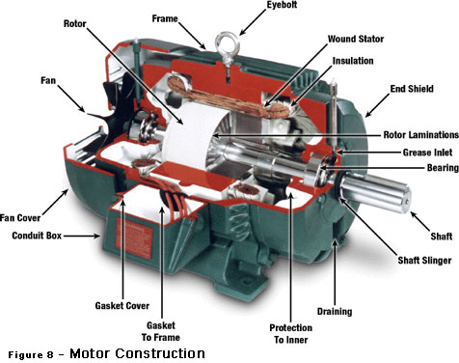
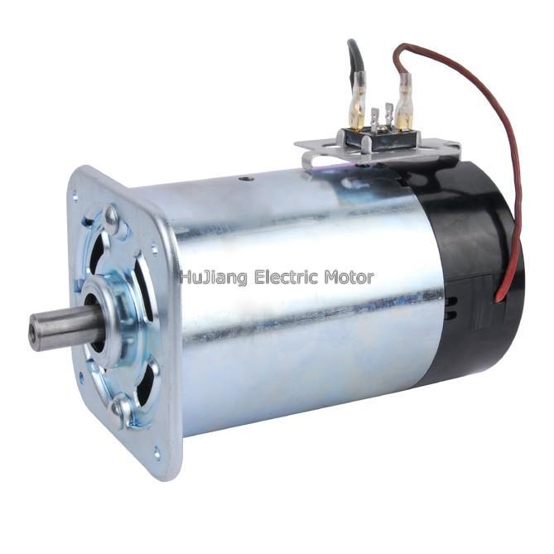
Motors
DC Motors

Slide 23
Controlling a DC Motor

Slide 24
H-bridge

Slide 25
Motor Speed

Slide 29
H-bridge Devices

Slide 30
Pulse Width Modulation

Slide 31
Stepper Motors

Slide 33
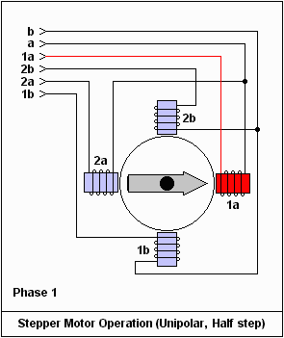
How Stepper Motors Work

Slide 37
Servo Motor

Slide 40
SENSOR DESIGN
Sensors as Transducers

Slide 41
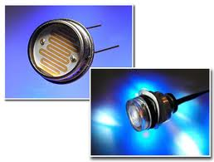
Photocells
changing their resistance

Slide 42
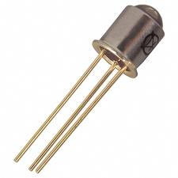
Phototransistors
changing their current flow

Slide 43
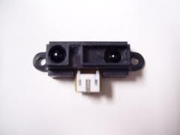
Sharp IR sensor
changing their voltage output

Slide 44
Analog and Digital Sensors

Slide 45
Analog Sensors
Photocell

Slide 46
Photocell
This device is a light-dependent resistor,
most sensitive to visible light,
made from a compound called cadmium sulfide (CdS).

Slide 47
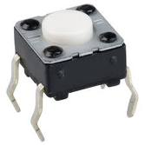
Digital Sensors
Touch switch

Slide 48
Sharp IR sensor

Slide 49
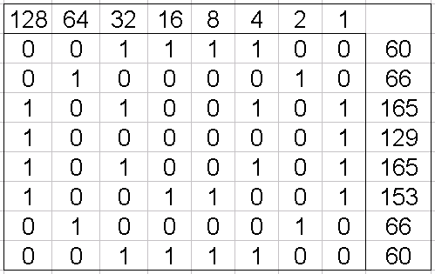
Sensor Inputs on the RoboBoard
The RoboBoard contains input ports for both analog and digital sensors.
Analog → measure the voltage and convert it to a number between 0 and 255,
voltage levels between 0 and 5 volts.

Slide 50
Light Sensors

Slide 51
Infrared Reflectance Sensor

Slide 52
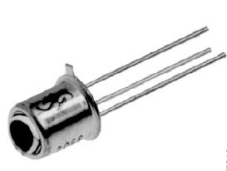
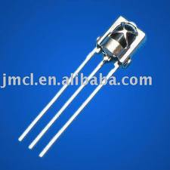
Infrared Slotted Optical Switch
Infrared LED phototransistor detector

Slide 53
Modulated Infrared Light Detector

