Slide 1
Republic of Yemen University of Science And Technology Faculty of science and Engineering BioMedical Engineering Department
Presentation of Robotics (1)
Supervised by:
DR. Fadhl M. Alakwaa PhD

Slide 2
Introduction To Robotics

Slide 3
HISTORY OF ROBOTICS
A robot:
is a virtual or mechanical artificial agent In practice, it is usually an electro-mechanical machine which is guided by computer or electronic programming, and is thus able to do tasks on its own.

Slide 4
Slaves of Steel

Slide 5
Wartime Inventions

Slide 6
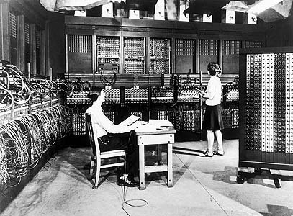
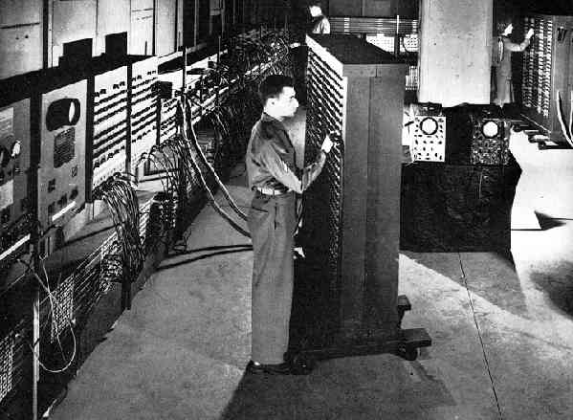
Calculators and Computers

Slide 7
Industrial-strength Arms

Slide 8
Early Personal Robots

Slide 9
Arms in Space

Slide 10
Surgical Tools

Slide 11
The Honda Humanoid

Slide 12
A Range of Rovers

Slide 13
Current Research In Robotics Around The World
According to MSN Learning & Research, 700,000 robots were in the industrial world in 1995 and over 500,000 were used in Japan, about 120,000 in Western Europe, and 60,000 in the United States.
Basically a robot consists of:
■ A mechanical device: such as a wheeled platform, arm, or other construction , capable of interacting with its environment.
■ Sensors on or around the device: That are able to sense the environment and give useful feedback to the device.
■ Systems that process sensory input in the context of the device’s current situation and instruct the device to perform actions in response to the situation.

Slide 14
fields of robotics can be broadly categorized as:
■ Robotic Manipulator
■ Wheeled Mobile Robots
■ Legged Robots
■ Underwater Robots
■ Flying Robots
■ Robot Vision
■ Artificial Intelligence
■ Industrial Automation

Slide 15
1-Robotic Arms “Manipulator “

Slide 16
2-Wheeled Mobile Robots

Slide 17
3-Legged Robots
Notes:
Locomotion on the ground can be realized with three different basic mechanisms:
(i) Slider,
(ii) Liver, and
(iii) Wheel or track.
the first two are walking mechanisms, and in these cases the robot moves on legs. So many robots have been designed that follow the walking mechanism.
The benefits that can be obtained with a legged robot are:
■ Better mobility
■ Better stability on the platform
■ Better energy efficiency
■ Smaller impact on the ground
Gait, which determines the sequence of supporting leg configurations during movement, is divided into two classes:
(i) Periodic gaits: They repeat the same sequence of supporting leg configurations.
(ii) Non periodic or free gaits: They do not have any periodicity in their gait pattern.
The number of different gaits depends on the number of legs.

Slide 18
4-Underwater Robots

Slide 19
5-Flying Robots

Slide 20
6-Robot Vision

Slide 21
7-Artificial Intelligence
Notes:
Artifi cial Intelligence (AI)
is a branch of computer science and engineering that deals with intelligent behavior, learning, and adaptation in machines. Research in AI is concerned with producing machines to automate tasks requiring intelligent behavior. Examples include control, planning and scheduling, the ability to answer diagnostic and consumer questions, handwriting, speech, and facial recognition. As such, it has become an engineering discipline, focused on providing solutions to real-life problems, software applications, traditional strategy games like computer chess, and other video games.

Slide 22
Basic Electronics

Slide 23
Basic Elements
Resistors
Capacitors
Poteintiometer
Leds

Slide 24
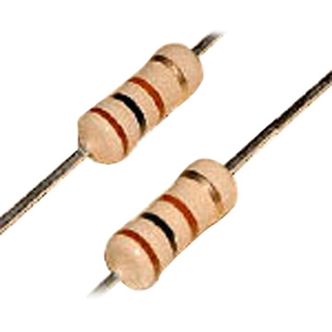
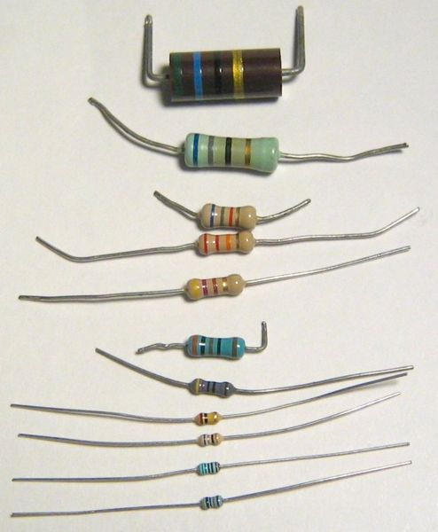
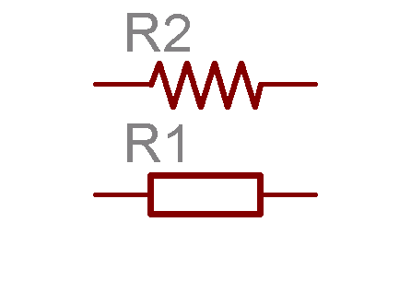
Resistors
Resistors are one of the most commonly used components in electronics. As its name implies, resistors resist the flow of electrons. They are used to add resistance to a circuit.

Slide 25
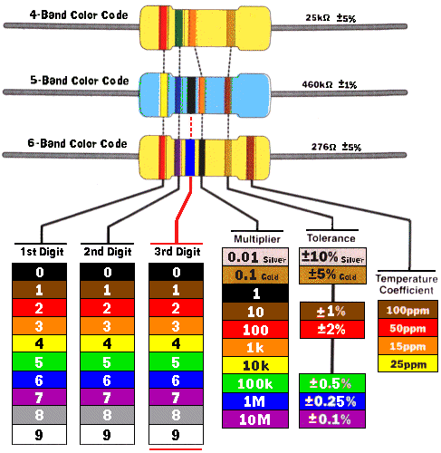

Slide 26
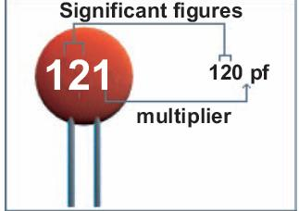
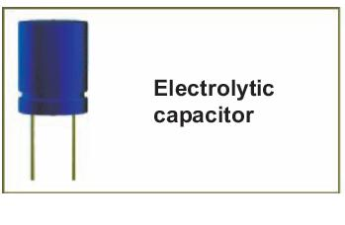
Capacitors
Types of the most commonly used capacitors:
(1)Ceramic (2)Electrolytic

Slide 27
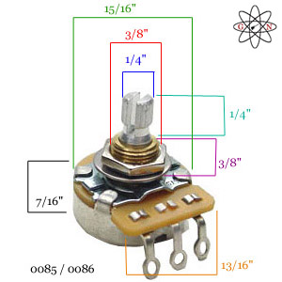
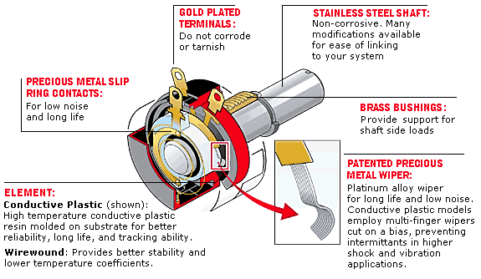
Potentiometer
It is commonly used for volume and tone controls in stereo equipment. On the RoboBoard a 10k pot is used as a contrast dial for the LCD screen

Slide 28
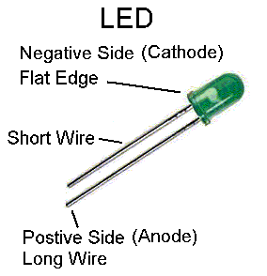
((LEDS Light Emitting Diodes

Slide 29
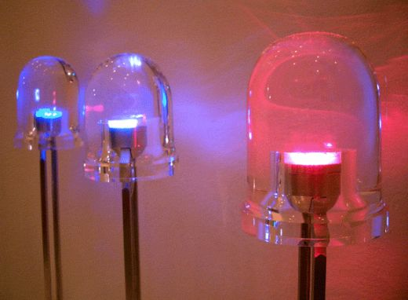
LED Benefits
■ Energy efficient
■ Compact size
■ Low wattage
■ Low heat
■ Long life
■ Extremely robust
■ Compatible with integrated circuits

Slide 30
LED Structure

Slide 31
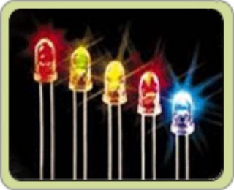
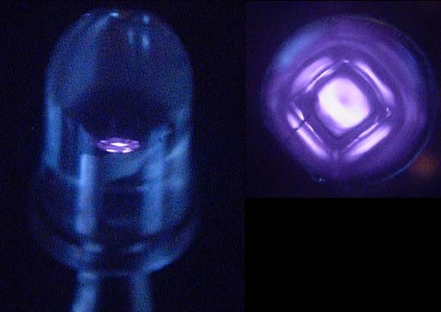
Classification:
(i) Visible LED (ii) Infrared LED

Slide 32
Applications of LEDs
Visible LED:
including indication devices for electronic appliances, measuring instruments, etc.
Bi-color (dual color) LED:
Charger for cellular phones, showcase boards, traffic boards on highways, etc.
High & Ultra Brightness LED:
Full-color display for indoor/outdoor, automotive signal lamps, high-mount lamps, indoor lamps, traffic signal lamps, etc.
Infrared LED:
With high output capacity, IR LED is used in remote controls, IrDa ( Infrared Data Storage Devices), etc.

Slide 33
Diodes

Slide 34
I-V characteristic of P-N junction diode

Slide 35
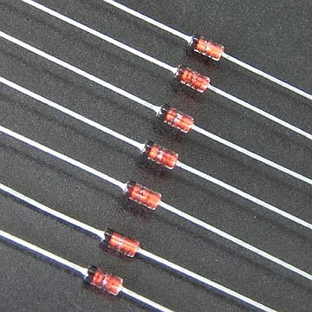
Zener Diode

Slide 36
Characteristics of Zener diode

Slide 37
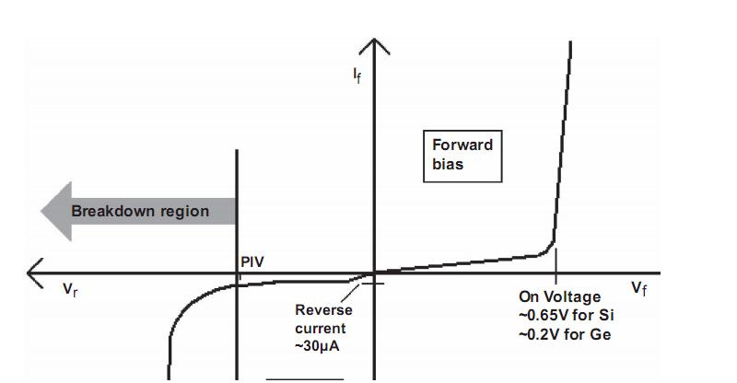
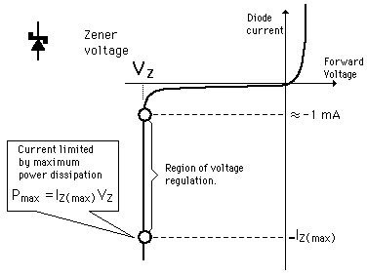
Comparison between diode and zener diode
Zener diode Normal diode

Slide 38
Varactor Diode

Slide 39
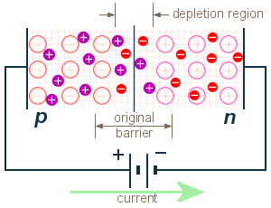
Characteristics of Varactor Diode

Slide 40
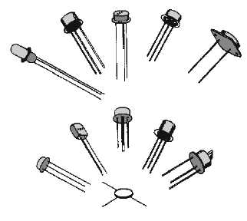
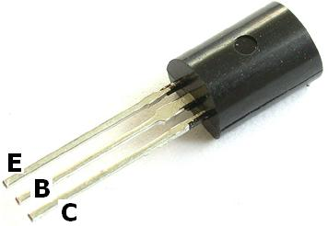
Transistors

Slide 41
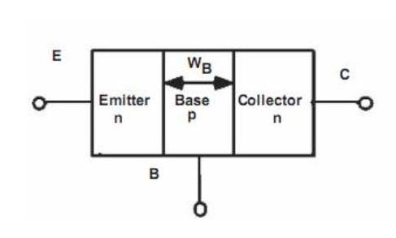
NPN Transistor

Slide 42
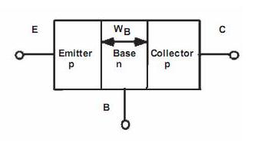
PNP Transistor

